Slide 1
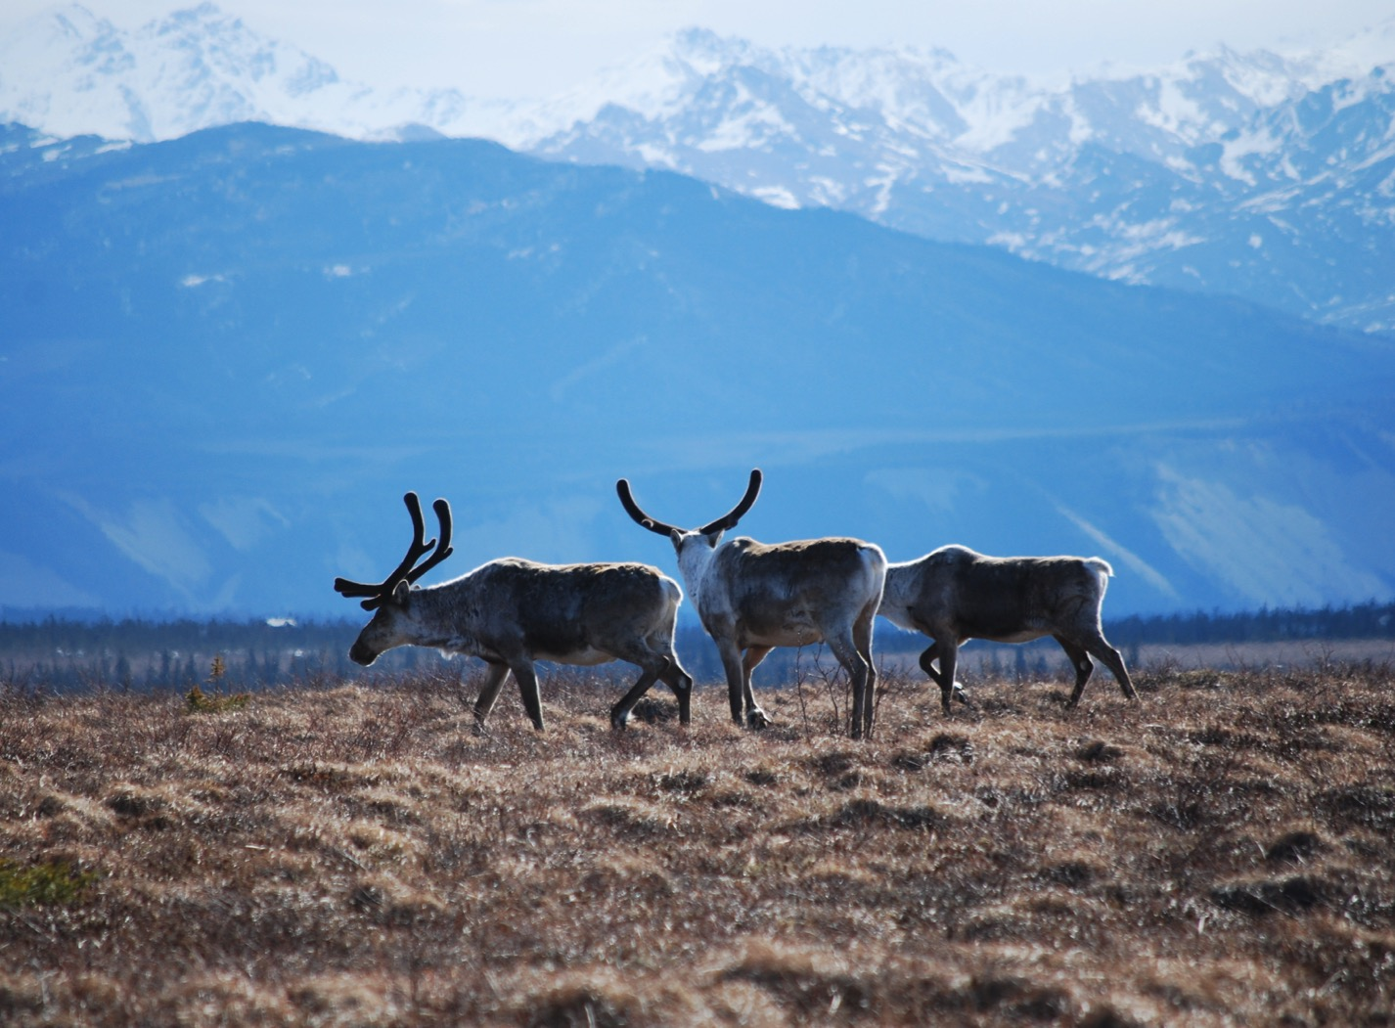
Arctic Boreal Vulnerability Experiment (ABoVE)
2017 ABoVE Airborne Campaign
13 July 2017 (DOY 194)
AVIRIS-NG: Deadhorse – Toolik Lake
Charles Miller, Deputy Science Lead
Jet Propulsion Laboratory, California Institute of Technology
and the ABoVE Science Team
For Hank Margolis, Eric Kasichke, Bruce Tagg
NASA HQ
2017

Slide 2

13 July 2017/DOY 194
Deadhorse – Toolik Lake
Daily Status:
AVIRIS-NG / N53W ABoVE CAMPAIGN (CANADA / ALASKA)
REPORT DATE: 8 July 2018
Current Status of Aircraft: Yellow
Current Status of AVIRIS: GREEN
Current Deployment Location: Fairbanks AK (PAFA)
Crew: Rogers, Heidt, Nolte, Sullivan
Science Coordinator: A Thorpe
Science Lead: C Miller
Project Managers: M Eastwood, I McCubbin
Instrument PI: R Green
Notes:
Aircraft avionics package continues to have intermittent loss of heading problems

Slide 3
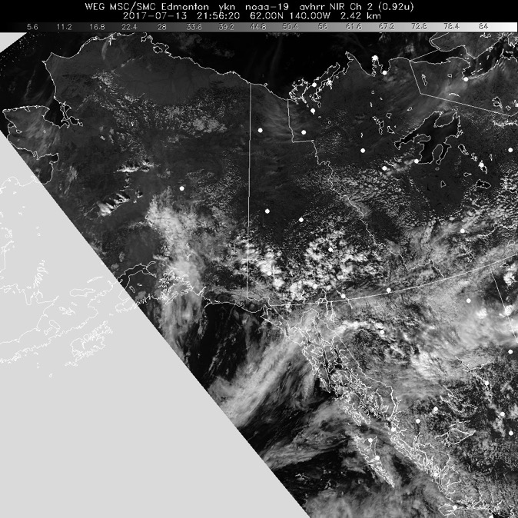
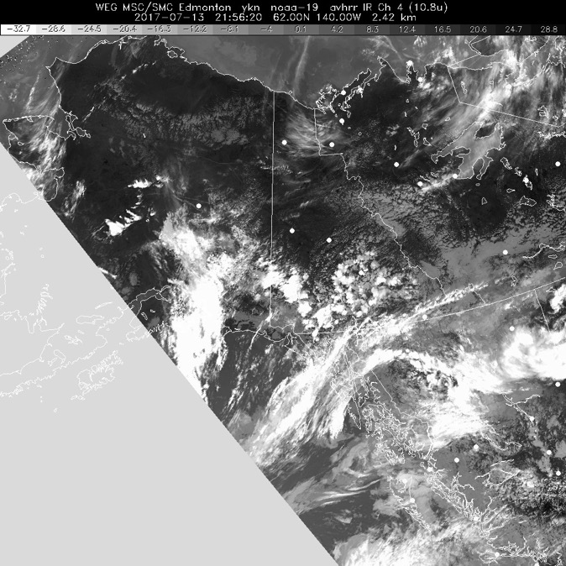
13 July 2017/DOY 194
Deadhorse – Toolik Lake
HRPT Vis
2156Z
HRPT IR
2156Z
Clear skies across the eastern North Slope with low level smoke from the Upper Yukon fires

Slide 4
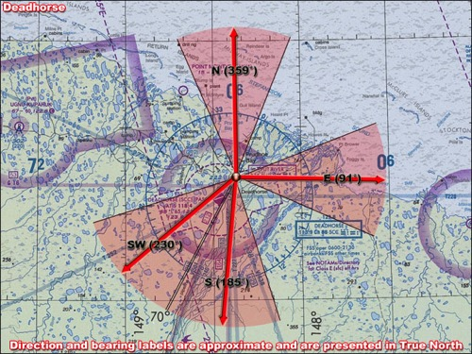
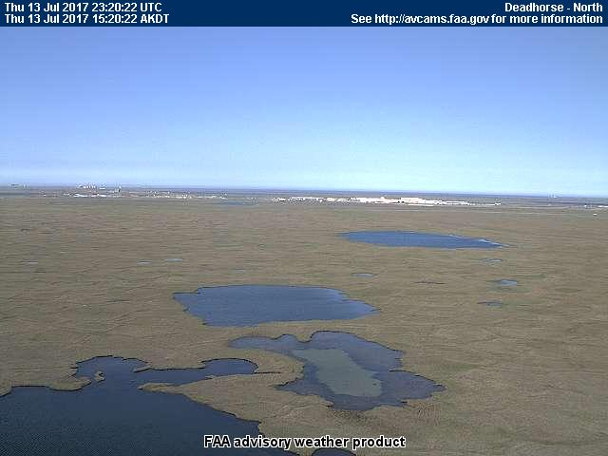
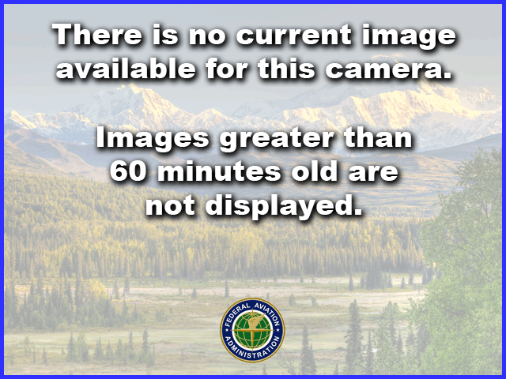
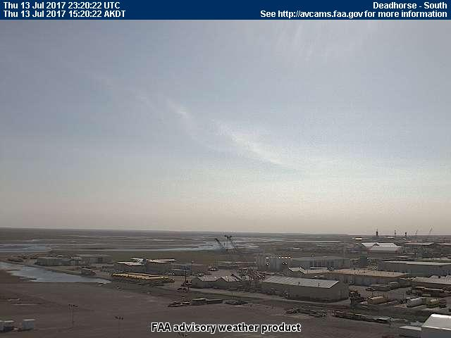
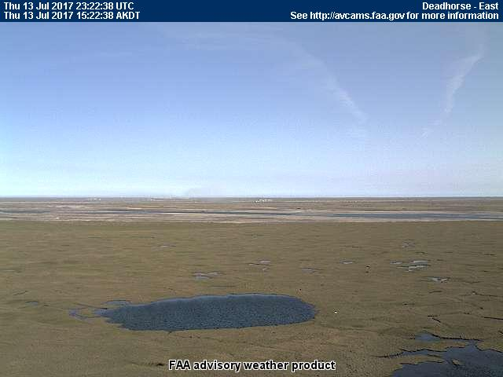
13 July 2017/DOY 194
Deadhorse – Toolik Lake
Deadhorse Airport (PASC)
North
Southwest
South
East
Notes:
AVCAM sky pictures from the Deadhorse Airport (PASC) at 1325 AKDT/2125 UTC showing extreme clear conditions and the sectional coverage of each camera. The SW camera was not functioning
See http://avcams.faa.gov/ for an interactive map of Alaska aviation cameras

Slide 5
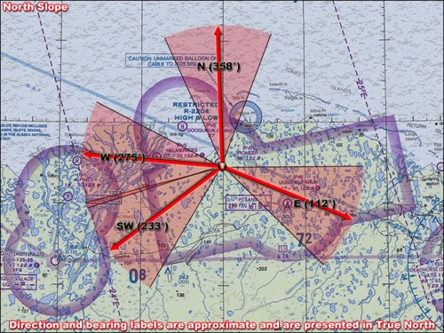
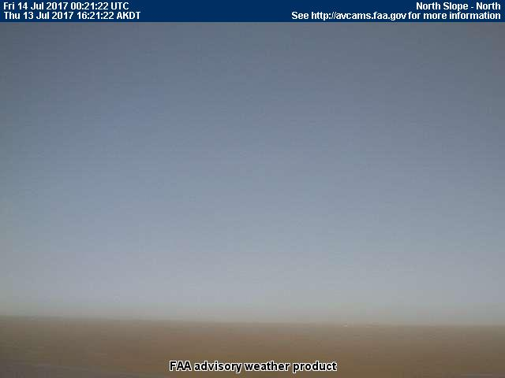
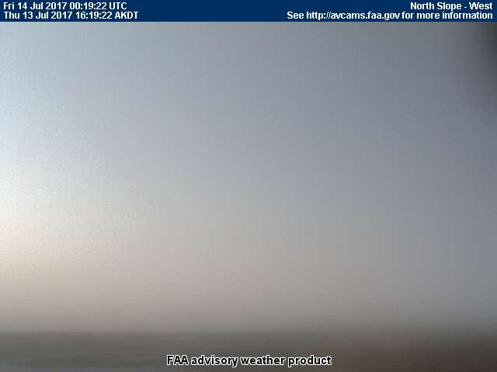
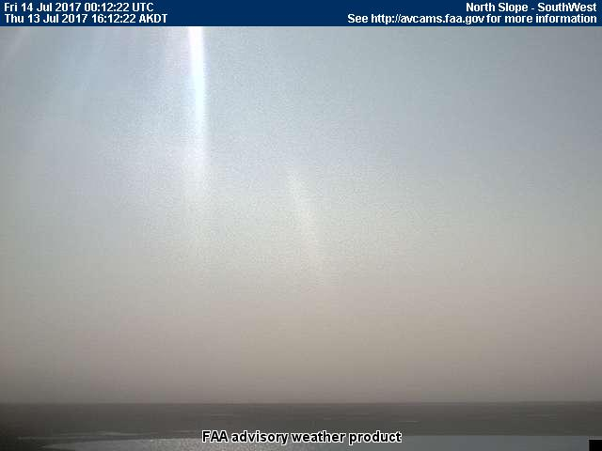
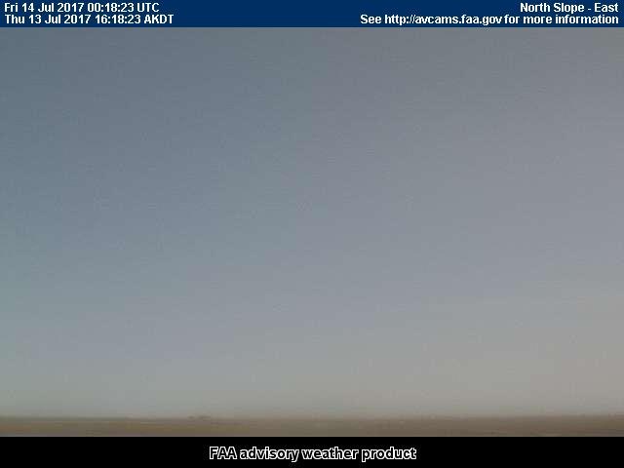
13 July 2017/DOY 194
Deadhorse – Toolik Lake
North Slope (AA27) (West of Deadhorse Near Colville Delta)
North
West
Southwest
East
Notes:
AVCAM sky pictures from the North Slope (AA27) air strip at 1435 AKDT/2235 UTC showing extreme clear conditions with some clouds on the horizon SW
See http://avcams.faa.gov/ for an interactive map of Alaska aviation cameras

Slide 6
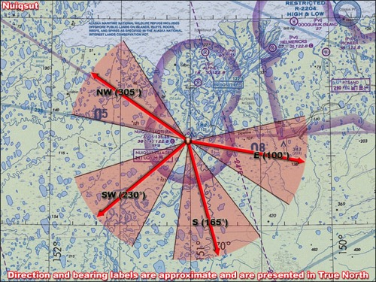
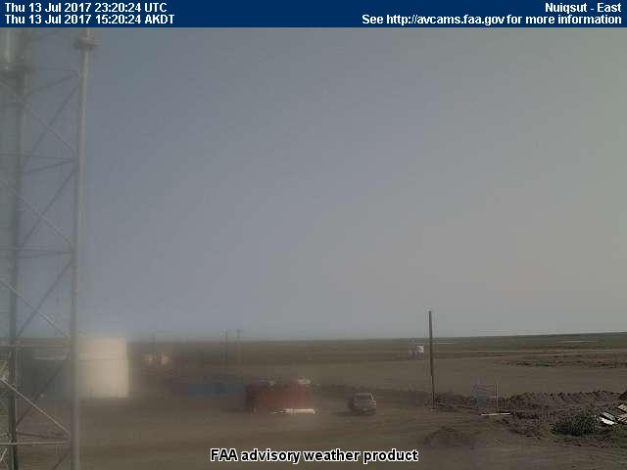
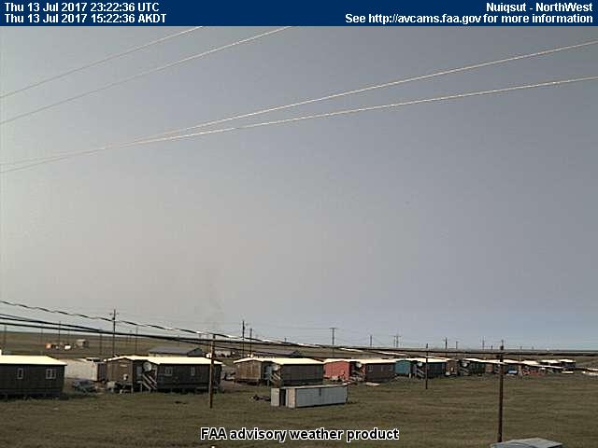
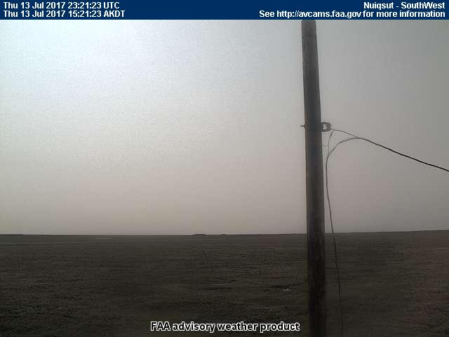
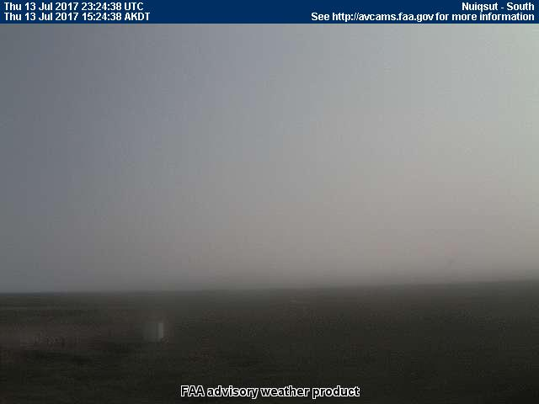
13 July 2017/DOY 194
Deadhorse – Toolik Lake
Nuiqsut (AQT) (PAQT, west of Deadhorse)
NORTH
Stevens Village
East
Northwest
Southwest
South
Notes:
AVCAM sky pictures from the Anaktuvuk Pass air strip at 1337 AKDT/2137 UTC showing extreme clear conditions and the sectional coverage of each camera. The SW camera was not functioning
See http://avcams.faa.gov/ for an interactive map of Alaska aviation cameras

Slide 7
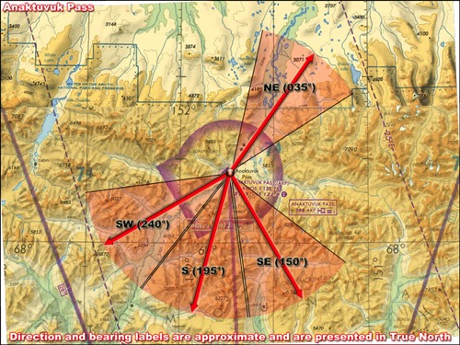
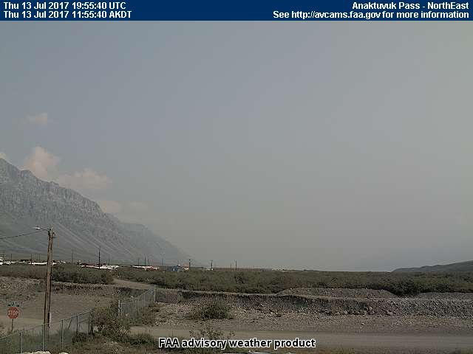
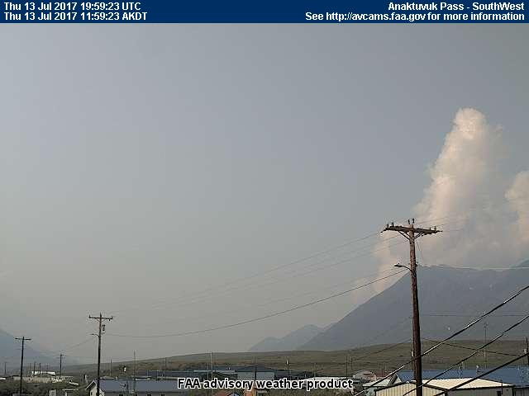
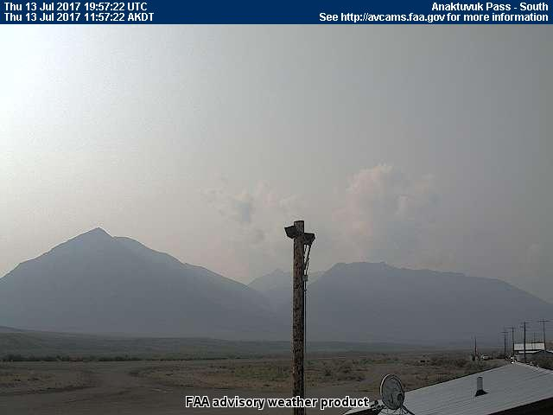
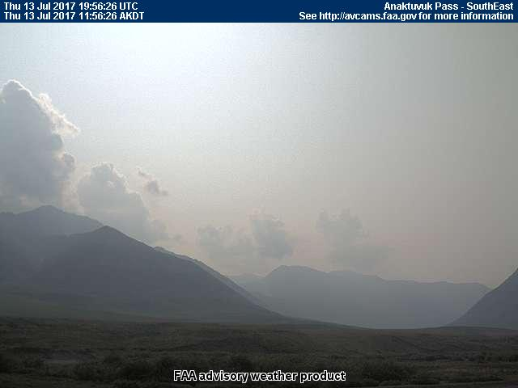
13 July 2017/DOY 194
Deadhorse – Toolik Lake
Anaktuvuk Pass (just south of Toolik Lake)
NORTH
Stevens Village
Northeast
Southwest
South
Southeast
Notes:
AVCAM sky pictures from the Anaktuvuk Pass air strip at 1337 AKDT/2137 UTC showing extreme clear conditions and the sectional coverage of each camera. The SW camera was not functioning
See http://avcams.faa.gov/ for an interactive map of Alaska aviation cameras

Slide 8
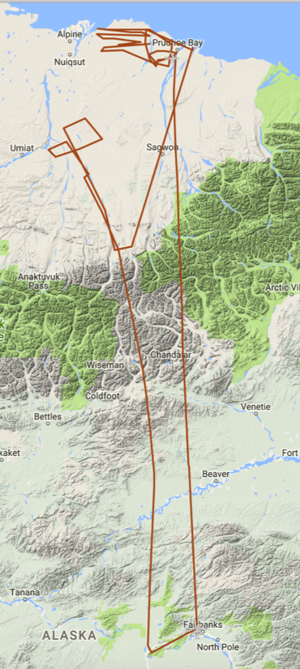
13 July 2017/DOY 194
Deadhorse – Toolik Lake
As-flown Lines & Acquisition Segments
Data Acquisitions:
Line 1, ID 19205: Lake Clark
Line 2, ID 32608: S River
Line 3, ID 26905: YK Delta 1
Line 4, ID 01811: YK Delta 2
Line 5, ID 01813: YK Coast
Line 6, ID 04215: Innoko
Line 7, ID 08911: Poorman
Line 8, ID 09115: Denali
Line 9, ID 30204: Delat Junc
26905
26906
19205
30204
Notes:
Glitches in as-flown flight lines due to intermittent tracker drop outs

Slide 9
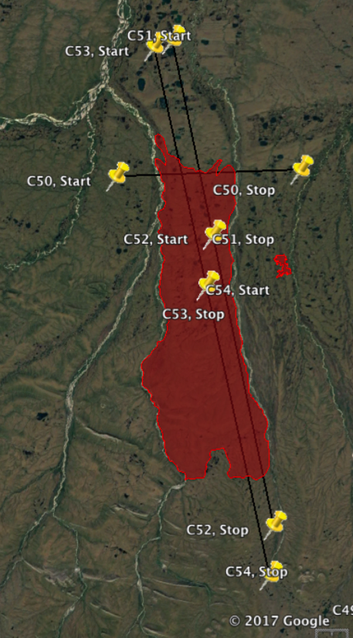
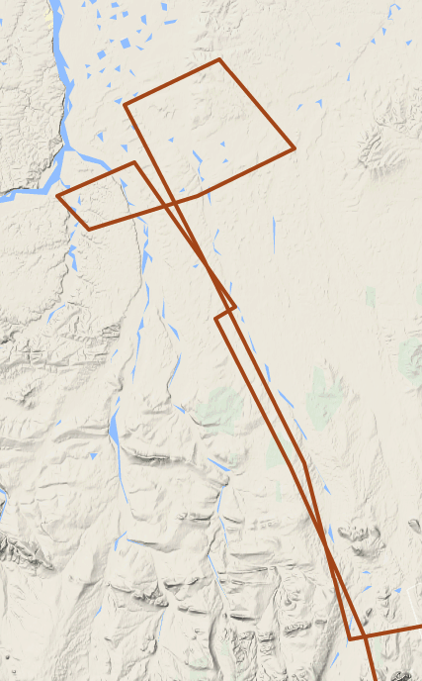
13 July 2017/DOY 194
Deadhorse – Toolik Lake
Anaktuvuk River fire scar Data Acquisitions:
C50, ID 19205:
C51, 2, ID 32608:
C52 3, ID 26905:
C53 4, ID 01811:
C54 5, ID 01813:
E13/303
E14/304
D4/225
D3/224
D2/223
D1/222
E16/306
E17/307
C60/217
Planned flight lines & acquisition segments
Notes:
Glitches in as-flown flight lines due to intermittent tracker drop outs

Slide 10
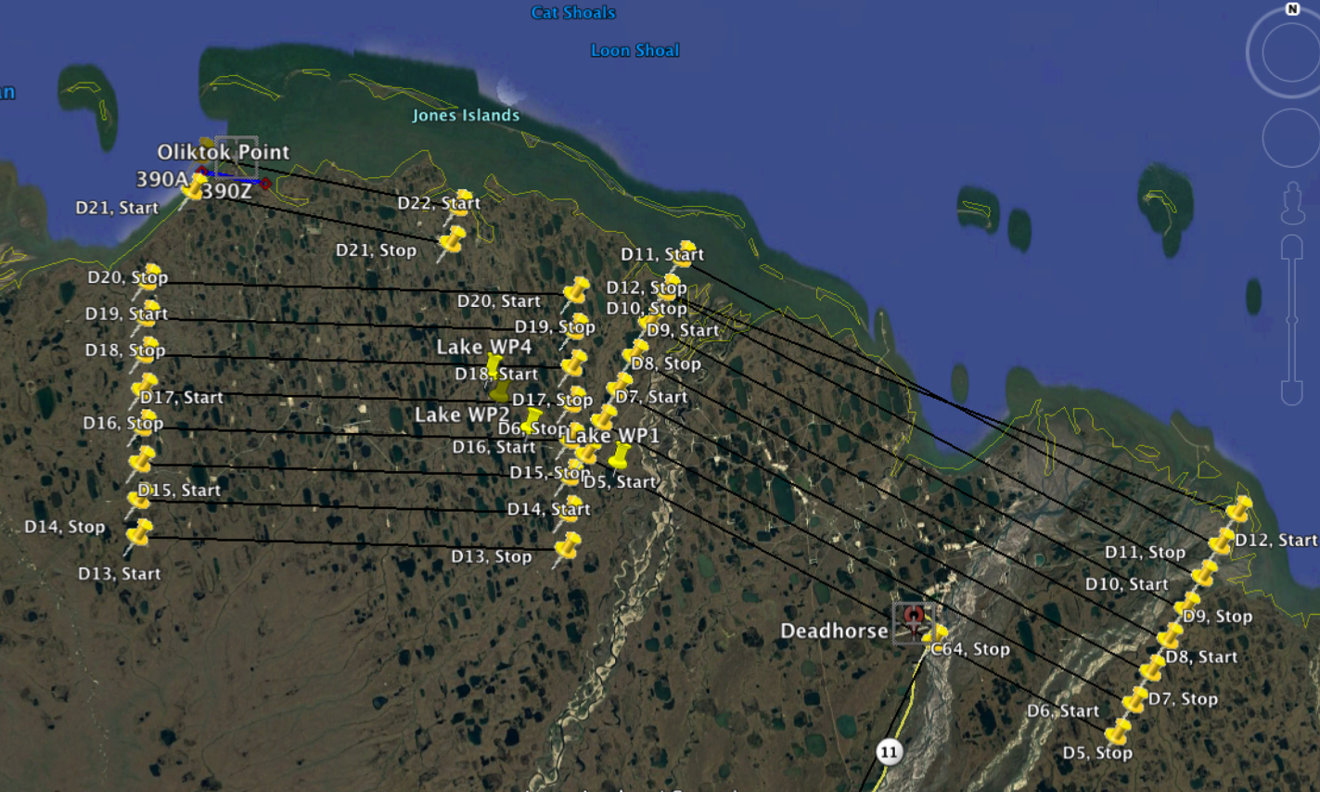
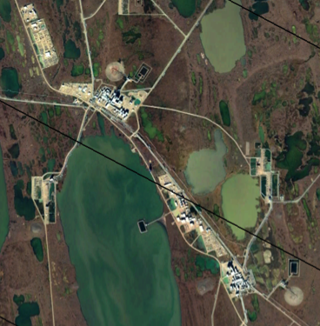
13 July 2017/DOY 194
Deadhorse – Toolik Lake
Deadhorse Area Detail: Planned acquisition segments for
methane plume detection over oil & gas production sites
Line D7 Detail
West Grid
East Grid
Notes:
Oil & gas production pads are seen as small sand-colored discolorations across the region

Slide 11
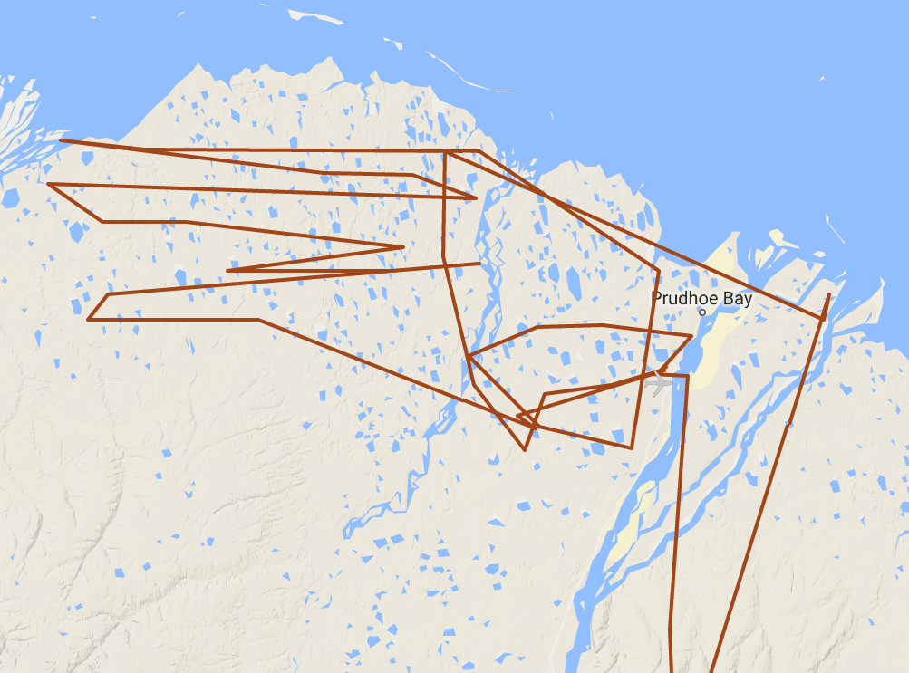
13 July 2017/DOY 194
Deadhorse – Toolik Lake
Deadhorse Area Detail: As-flown Acquisition Segments
Energy Grid West:
Lines D21-D13
Energy Grid East:
Lines D12-D5
Notes:
Glitches in as-flown flight lines due to intermittent tracker drop outs

Slide 12
13 July 2017/DOY 194
Deadhorse – Toolik Lake
AVIRIS-NG Quick-look products
https://avirisng.jpl.nasa.gov/cgi/flights.cgi?step=view_flightlog&flight_id=ang20170713t
A. Line C54, Track Air #211, Run ID 190553: Anaktuvuk fire scar
B. Line C53, Track Air #210, Run ID 192145: Anaktuvuk fire scar
Winston Olson-Duvall, JPL
A
B
A. Discoloration from 2007 burn; excessive popcorn clouds in middle of this image
B. Discoloration from 2007 burn transitions to more normal green as line passes over the burn into undisturbed tundra

Slide 13
13 July 2017/DOY 194
Deadhorse – Toolik Lake
AVIRIS-NG Quick-look products
https://avirisng.jpl.nasa.gov/cgi/flights.cgi?step=view_flightlog&flight_id=ang20170713t
A. Line C51, Track Air #208, Run ID 195536: Anaktuvuk fire scar
B. Line C52, Track Air #209, Run ID 201001: Anaktuvuk fire scar
Winston Olson-Duvall, JPL
A
B
A. Perpendicular transect along the northern portion of the burn scar – burn was between the 2 rivers
B. Discoloration from
Notes:
C51 & C52 = continuous N-S transect along the long dimension of the burn scar

Slide 14
13 July 2017/DOY 194
Deadhorse – Toolik Lake
AVIRIS-NG Quick-look products
https://avirisng.jpl.nasa.gov/cgi/flights.cgi?step=view_flightlog&flight_id=ang20170713t
A. Line C50, Track Air #207, Run ID 193807: Anaktuvuk fire scar – perp N transect
B. Line C48, Track Air #205, Run ID 202702: NEON Toolik Lake box; Imnaviat Creek
Winston Olson-Duvall, JPL
A
B
A. Perpendicular transect along the northern portion of the burn scar – burn was between the 2 rivers
B. Popcorn clouds scattered throughout the image

Slide 15
13 July 2017/DOY 194
Deadhorse – Toolik Lake
AVIRIS-NG Quick-look products
https://avirisng.jpl.nasa.gov/cgi/flights.cgi?step=view_flightlog&flight_id=ang20170713t
A. Line D12, Track Air #233, Run ID 210131: Deadhorse Energy Grid East
B. Line D11, Track Air #232, Run ID 211515: Deadhorse Energy Grid East
Winston Olson-Duvall, JPL
A
B
A. Interesting coastal water imagery
B. Many oil & gas facilities as well reclamation pools in this image
Notes:
D12 and D11 cross each other @ 45 deg, image much of the same terrain and coastal waters
Majority of the Sag River Delta imaged

Slide 16
13 July 2017/DOY 194
Deadhorse – Toolik Lake
AVIRIS-NG Quick-look products
https://avirisng.jpl.nasa.gov/cgi/flights.cgi?step=view_flightlog&flight_id=ang20170713t
A. Line D9, Track Air #230, Run ID 212839: Deadhorse Energy Grid East
B. Line D11, Track Air #232, Run ID 211515: Deadhorse Energy Grid East
Winston Olson-Duvall, JPL
A
B
Quicklook in process
A. Several oil & gas facilities, pipelines, etc
B. TBD

Slide 17
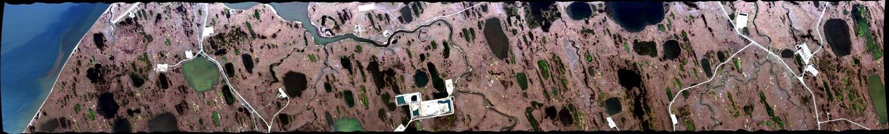
13 July 2017/DOY 194
Deadhorse – Toolik Lake
AVIRIS-NG Quick-look products
https://avirisng.jpl.nasa.gov/cgi/flights.cgi?step=view_flightlog&flight_id=ang20170713t
A. Line D21, Track Air #242, Run ID 215054: Deadhorse Energy Grid West
B. Line D20, Track Air #241, Run ID 000338: Deadhorse Energy Grid West
Winston Olson-Duvall, JPL
A
B
A. A large facility seen near the center of this image
B. Mostly roads & pipelines

Slide 18
13 July 2017/DOY 194
Deadhorse – Toolik Lake
AVIRIS-NG Quick-look products
https://avirisng.jpl.nasa.gov/cgi/flights.cgi?step=view_flightlog&flight_id=ang20170714t
A. Line D19, Track Air #240, Run ID 001457: Deadhorse Energy Grid West
B. Line D18, Track Air #239, Run ID 002620: Deadhorse Energy Grid West
Winston Olson-Duvall, JPL
A
B
A. Facilities intermixed with small, bright green lakes
B. Mostly roads & pipelines

Slide 19
13 July 2017/DOY 194
Deadhorse – Toolik Lake
AVIRIS-NG Quick-look products
https://avirisng.jpl.nasa.gov/cgi/flights.cgi?step=view_flightlog&flight_id=ang20170714t
A. Line D17, Track Air #238, Run ID 003820: Deadhorse Energy Grid West
B. Line D16, Track Air #237, Run ID 004926: Deadhorse Energy Grid West
Winston Olson-Duvall, JPL
A
B
A. Portions of a large facility complex at the end of the image
B. Major facility and road network in the middle third of this image

Slide 20
13 July 2017/DOY 194
Deadhorse – Toolik Lake
AVIRIS-NG Quick-look products
https://avirisng.jpl.nasa.gov/cgi/flights.cgi?step=view_flightlog&flight_id=ang20170714t
A. Line D15, Track Air #236, Run ID 010055: Deadhorse Energy Grid West
B. Line D14, Track Air #235, Run ID 011326: Deadhorse Energy Grid West
Winston Olson-Duvall, JPL
A
B
A. Many facilities
B. Major facility and road network in the middle third of this image

Slide 21
13 July 2017/DOY 194
Deadhorse – Toolik Lake
AVIRIS-NG Quick-look products
https://avirisng.jpl.nasa.gov/cgi/flights.cgi?step=view_flightlog&flight_id=ang20170714t
Line D13, Track Air #234, Run ID 012440: Deadhorse Energy Grid West
Winston Olson-Duvall, JPL
A
B
A. Furthest south of the Energy Grid West lines – no more development

Slide 22
BACKUP

Slide 23
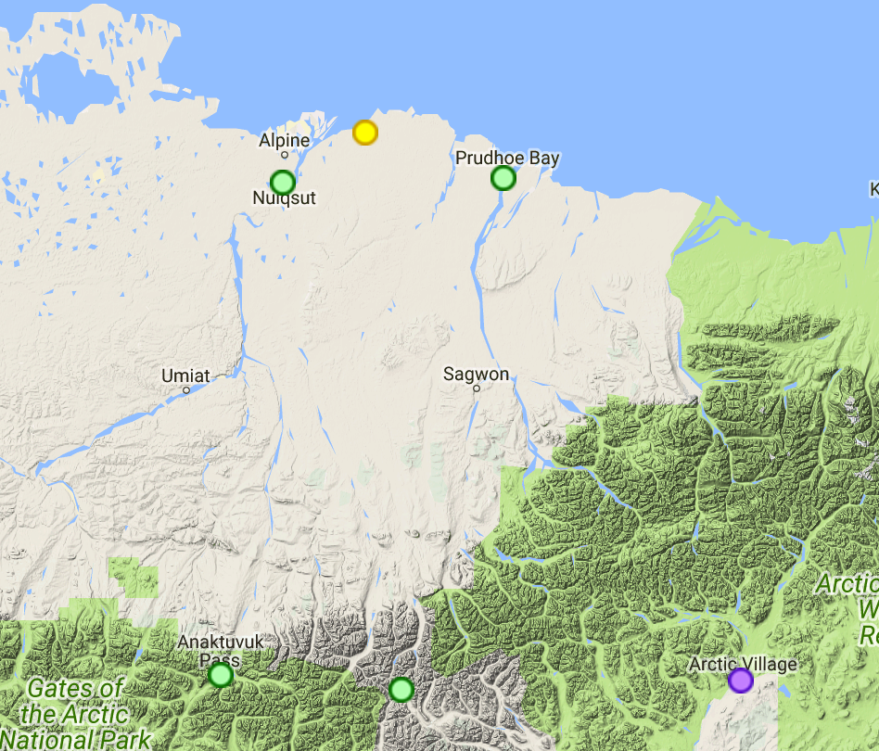
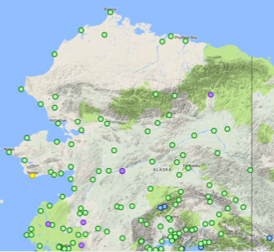
Deadhorse Area
FAA Webcamera Locations

